Slide 1
Switching to Local
Practical guide
How to collect information and arguments for a wage bargaining agreement
November-December 2022
Szilvia Borbély
Project: 101048392 — Switching to Local — SOCPL-2021-INFO-WK

Slide 2
Project: 101048392 — Switching to Local — SOCPL-2021-INFO-WK
CONCEPTS
SOURCES OF INFORMATION
GATHERING INFORMATION FOR THE BARGAINING
COMPARISONS
THE NEGOTIATION
SOURCES – MORE INFORMATION

Slide 3
INTRODUCTION
To be successful, workplace wage negotiations require serious preparation on the part of the participants - workers' representatives, trade unions, employees, etc. This guide aims to help you do that.
The first step to pay bargaining in the workplace is to collect data on your own company, directly or indirectly related to payroll (wages, earnings, productivity, headcount, etc.), broken down as necessary - or possible.
The second step in workplace wage negotiations is to collect labour market data to position the company. It is important to see where your company stands in relation to other companies in its sector, sub-sector or specialism, the national economy as a whole, or even the EU or Member States of particular interest to you.

Slide 4
CONCEPTS

Slide 5
Basic salary
The basic wage is the personal (hourly, weekly, monthly or annual) basic wage or salary laid down in the worker's contract of employment. It is the most important component of a worker's earnings
Average earnings
Average earnings are calculated by dividing the total earnings for the reference period (hour, month, year) by the average number of persons employed during the same period. Unless otherwise indicated, average earnings figures in various publications refer to full-time employees.
Median/average wage (average wage)
If all salaries were ranked, the median wage would be the one with exactly half the data above and half the data below. This contrasts with the average wage, which is calculated by adding up all the salaries in the data set and dividing by the total number of salaries.
Premium
A bonus is a fixed amount paid to employees for performing predefined tasks.
CONCEPTS

Slide 6
Workplace bonuses
Bonuses and allowances are regularly given to compensate for special working conditions, special skills, special job requirements (specific working conditions) or for a non-standard work schedule, if these factors are not taken into account when determining the employee's basic personal wage or performance-related pay.
The most common bonuses and allowances (not included in the basic salary) are:
bonuses for shift work (e.g. bonuses for afternoon or night shifts),
bonuses paid for special working conditions (e.g. hot work bonuses),
bonuses paid for a special position or qualification (e.g. seniority, title and sectoral bonuses for civil servants, special professional examination bonuses for government officials, special knowledge bonuses, notary's chief executive bonus, notary's bonus, foreign language bonus, etc.)
overtime allowances (including allowances for working on days off and public holidays),
bonuses for apprentices and retrainees,
bonuses for standby and inspection
bonuses paid at special sites for installation and construction work,
other bonuses provided for by law or collective agreement (driving bonus, bonus for work in hazardous working conditions).
CONCEPTS

Slide 7
Payments for periods not worked
Payments for time not worked are payments for time not worked in accordance with the law or collective agreement applicable to the employment relationship. The term typically refers to remuneration for absence. These are:
wages and salaries paid for ordinary (basic or additional annual leave) and extraordinary leave (i.e. leave), including paid remuneration if the employee worked in lieu of leave and the leave was compensated by a cash payment,
wages and salaries paid for study leave (or time off for study purposes),
pay for rest days and public holidays if the worker did not work on these days,
if the worker has worked on a public holiday or rest day because of his working pattern, payment for the day off in lieu of the day worked,
remuneration for the use of the time allowance provided for in the regulations for trade union officers and works council members,
the supplementary part of the wages or salary of pregnant women assigned to light work which the regulation provides for the payment of in order to enable them to attain their previous earnings,
the supplementary wages or salaries paid to nursing (breastfeeding) mothers during the period of the working time allowance,
pay for breaks between work periods,
the wages and salaries of workers sent on training or study visits (payable by the employer),
payment for travel time on official missions,
wages paid to workers on temporary 'compulsory leave' due to the employer's difficult economic circumstances or on reduced working hours due to the reduction of daily working time,
remuneration paid by the employer, by agreement, during the strike,
wages for working time lost because of a justified refusal to carry out an order,
compensation for frost damage,
Wages and salaries paid in the cases provided for in the Regulation where the worker is exempted from the obligation to work (e.g. remuneration for paid absence during the period of a civil obligation or compulsory medical examination).
Source: Central Statistical Office (KSH), Metainformation
C
O
N
C
E
P
T
S

Slide 8
CONCEPTS
Nominal wage/real wage
The nominal wage is the wage expressed in money, regardless of its purchasing power. Real wages, on the other hand, are the inflation-adjusted level of nominal wages, i.e. the amount of goods and services that can be purchased with wages.
Gross/net wages
From gross wages, we deduct social security tax, health tax, pension contributions, unemployment contributions and personal income tax to obtain net wages. The employer's total wage costs are obtained by adding the taxes payable by the employer to the gross wage.
Attention! Taxes and contributions on wages change! (It can and has happened that percentages change during the year). Always check the current values!
An example: composition of labour costs in Hungary, 2022
Gross wage | Personal income tax | Social security contribution | Net wage | Social contribution tax paid by the employer | Total wage cost (gross wage + social contribution tax paid by the employer)
HUF | 15% | 18,5% | HUF | 13% | HUF
300000 | 45000 | 55500 | 199500 | 39000 | 339000

Slide 9
CONCEPTS
The tax wedge
The tax wedge is the sum of personal income tax and employee and employer social security contributions, excluding family allowances, expressed as a percentage of total labour costs (total labour costs (or total wage costs), as we have seen, are the sum of gross wages and social security contributions paid by the employer).
Calculation of the tax burden on labour in the example above: total tax and contribution burden / wage cost X 100 = 45000+55500+39000)/339000) = 41%.
Note that in 2020, this value was 43% in Hungary, 41% in Portugal and 39.7% in Turkey; the average for OECD countries is much lower at 34%.
(Source: OECD Taxable Wages 2021).

Slide 10
SOURCES OF INFORMATION

Slide 11
No deal can be done without the right data.
But where can we find the REQUIRED DATA?
Company data, balance sheets
Management must make company data available to employees and their negotiators (trade union, works council).
The publicly available balances also provide a lot of information on the possible limits of the deal.
Public business information portal
In Hungary, after entering a few details (company name or company registration number or tax number), you can search the mandatory publication of company accounts and balance sheets on the company information portal run by the Ministry of Justice.
Sources in Hungary:
https://ebeszamolo.im.gov.hu/oldal/beszamolo_kereses

Slide 12
Other sources
KSH - CENTRAL STATISTICAL OFFICE
Labour Force Survey
Institutional labour statistics - these cover enterprises with five or more employees and institutions with full budgetary and non-profit employment significance
Labour costs
Wages
Social security contributions
and much more about EU countries
EUROSTAT - the statistical database of the European Union
Links to the Eurostat database:
https://ec.europa.eu/eurostat/web/labour-market/labour-costs/main-tables
https://ec.europa.eu/eurostat/web/labour-market/labour-costs/database

Slide 13
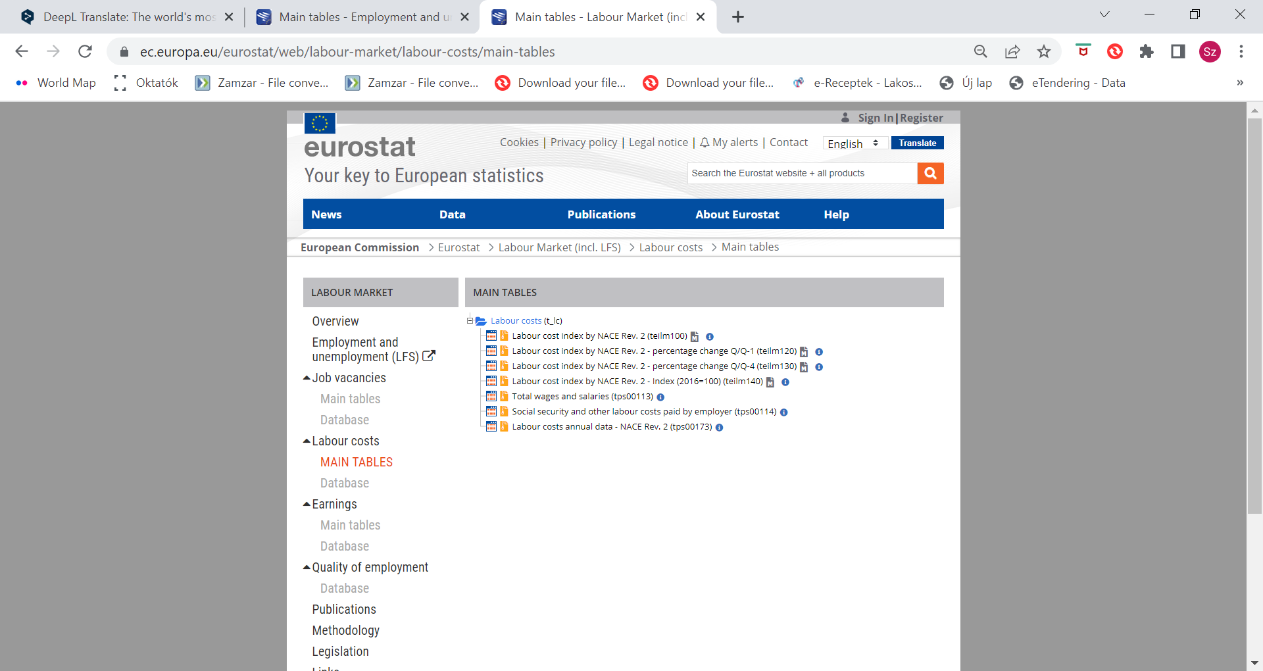
More sources
International Labour Organisation (ILO) wage statistics
https://ilostat.ilo.org/topics/wages/
OECD wage statistics
https://data.oecd.org/earnwage/average-wages.htm

Slide 14
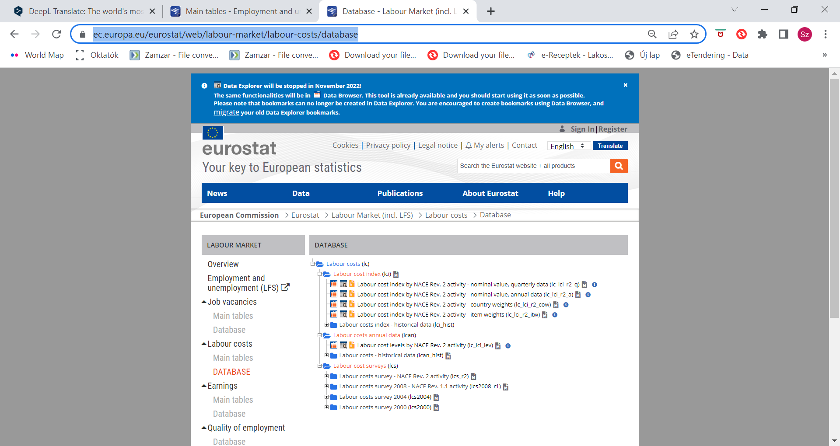

Slide 15
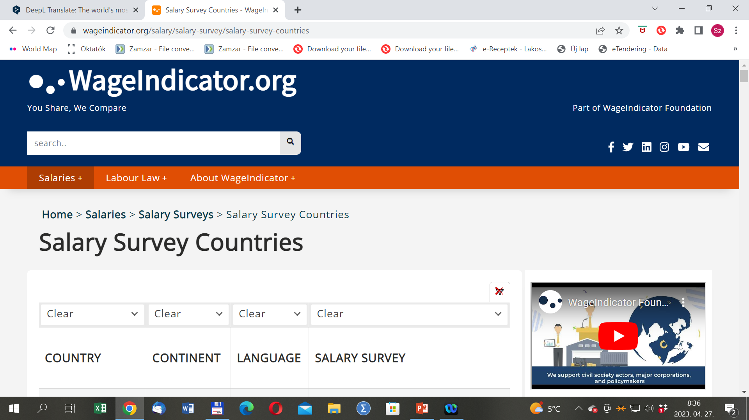
Alternative information sources
Attention!
These data are often based on self-reported surveys. They also stress that the data are for information purposes only.
Link to an example:
https://wageindicator.org/salary/salary-survey/salary-survey-countries

Slide 16
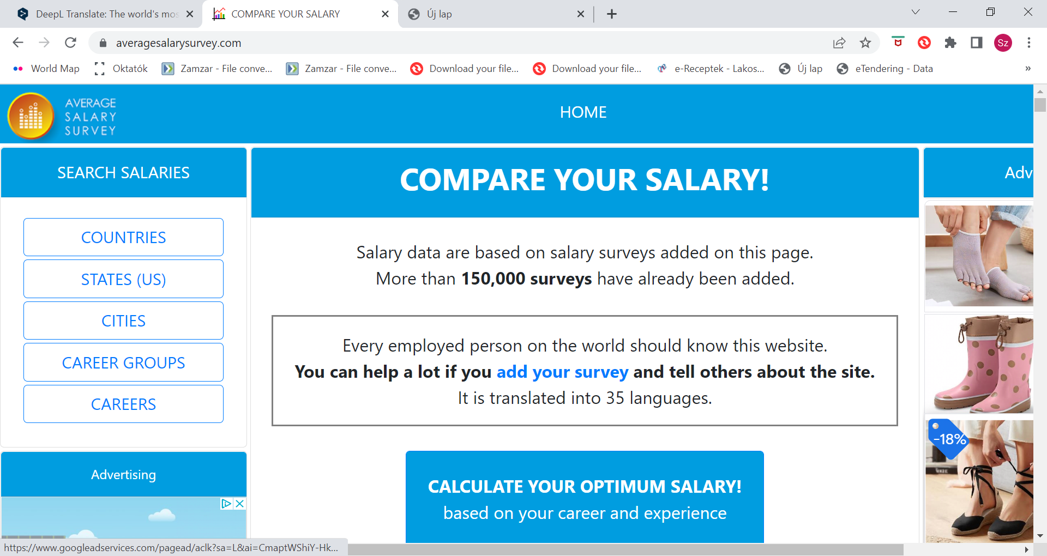
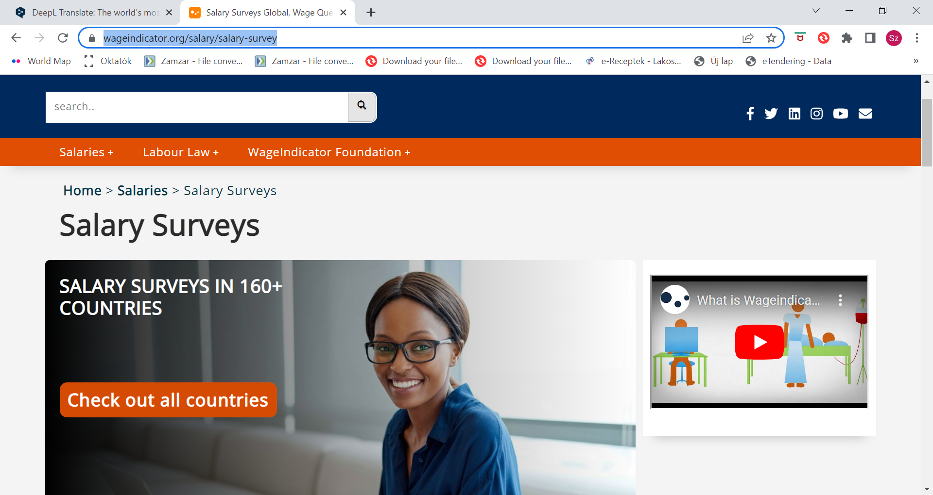
Alternative websites for international comparisons
https://www.averagesalarysurvey.com/hu/
https://wageindicator.org/salary/salary-survey

Slide 17
GATHERING INFORMATION FOR ARGUMENTATION

Slide 18
Gather information on the national economy - the company's indirect operating space - and on the company
Where does our company and its performance stand compared to other companies in the economy?
How is our commitment?
What are the indicators we need to watch?
Labour productivity
How much output per unit of labour is generated (either in the economy as a whole or in a single firm)
Quantitative measurement: how many parts, applications, products or calls can be processed per hour, per day or per month by one worker.
There are software that measure and calculate average daily production or the hourly, daily or monthly productivity of each employee (e.g. nTask, Basecamp, Asana, etc.)
Attention!!!!
Indicators can be status indicators for a given year or process indicators showing the dynamics of several years.
Trends in the company's performance, profitability, efficiency, assets and financial position - based on the company profit and loss account and balance sheet

Slide 19
Performance indicators
The company profit and loss account provides information on the company's performance (success) and its ability to generate income in a given period.
Annual result = annual revenue (turnover) - expenses (costs)
Measures of performance
net sales revenue
profit after tax
Performance ratios
net sales per employee
profit after tax per equity
Return on equity (ROE) - Return on equity (after tax profit/average equity) - shows the profitability of capital, the higher the value of the indicator, the better the profitability of capital.
Return on Assets (ROA) - Return on Assets (profit after tax/average assets) - the higher the value of the indicator, the higher the return on assets of the company
Profitability indicators

Slide 20
Inventory turnover rate: net sales/inventories
Net sales per capita: net sales/average number of employees
Efficiency indicators
Liquidity indicators
They allow us to draw conclusions about the financial situation of the company (liquidity ratio, liquidity quick ratio).
Liquidity ratio = Current assets/ current liabilities
If the value of the indicator is less than 1 the company is insolvent
A value of around 1,5 to 1,8 is acceptable
The company's creditors (mainly short-term creditors) favour a higher liquidity ratio.
Liquidity quick ratio = current assets - inventories / current liabilities
If the ratio is greater than 1, it means that the company is able to pay its liabilities due within the year from its assets that can be turned into cash relatively quickly.
Attention!!!!!
A
weakening/strengthening of the domestic currency has an impact on export market revenues (if the company produces mainly for export); and/or costs (e.g. if the company produces a product with a high import content). These will affect the company's net sales and wage bargaining opportunities.

Slide 21
Gathering information about the company's situation and operations
Where do we stand and what room for manoeuvre do we have to bargain?
You need to be aware of the following:
Company performance (current status and recent trends)
Strategic plans for the market - plans for change
The market for the company's production - market position; export or domestic market
Import content of the product - market situation for imported products
Reading the balance sheet
Wage information of the company (average wage, median wage; broken down by occupation, education, age groups, gender, managerial/non-managerial status and any other available data).
Income and its usual composition in the enterprise
7.1. overtime pay
7.2. evening or night work allowance
7.3. allowances for heavy work
7.4. premium for working on Sundays
7.5. regular salaryholiday pay
7.6. Christmas bonus13th, 14th month's paybonus linked to company performance
7.7. other non-wage benefits - transport allowance
7.8. meal allowance/meal voucher
7.9. other vouchers
8. Situation of the company's employees (number, breakdown by age, education, occupation, gender)
9. collective/wage agreement in the company

Slide 22
Consumer price index - indicates the rate of inflation, money depreciation
Another important determinant of claims is the rise in prices, the decline in the purchasing power of money.
Inflation above 10% per year is now called galloping inflation.
The Hungarian KSH (Central Statistical Office) measures domestic inflation using a consumer basket of 949 goods/services, the prices of which are obtained by sampling. However, the composition of the basket is problematic in that it does not adequately reflect the consumption of families in different life situations (e.g. it includes items such as cat shots, 72-hour rental of wedding dresses, etc.).
KSH redesigns the so-called representative list annually.
Attention!!!!! In wage bargaining, demanding a wage increase in line with inflation means that workers' living wage in real terms will only remain flat. It should also be taken into account that the consumption structure of different strata differs substantially and so does their cost of living.
The KSH website shows the monthly average change in the consumer price of certain products.
Link: https://www.ksh.hu/stadat_files/ara/hu/ara0044.html)
Link to the representative list: https://www.ksh.hu/docs/hun/modszgyors/farmodsz21.html).
Link to an international Cost of living survey:
https://wageindicator.org/salary/living-wage/wageindicator-cost-of-living-survey

Slide 23
This usually has a positive pull effect (you cannot pay less than this).
However, a negative wage effect has sometimes been observed; employers have financed the cost of the mandatory minimum wage increase without raising the wages of others accordingly.
Mandatory minimum wage
Figyelem!!!!
Ha gyenge a béralku, fennáll annak a veszélye, hogy a munkavállalók jelentős részének a bére beragad a minimálbér körül, és ezzel lefelé húzza a medián- vagy átlagbéreket is.
The European Union directive adopted in autumn 2022 proposes two methods for Member States to set the minimum wage:
create a real-price basket of locally available goods and services;
Use a benchmark, set at 60% of the median gross wage or 50% of the average gross wage.
Member States should establish a procedural framework for setting the minimum wage on the basis of clear criteria and updating it at least every two years (every four years for countries using an automatic indexation mechanism).
Link to the English version of the Directive: https://eur-lex.europa.eu/legal-content/EN/TXT/PDF/?uri=CELEX:52020PC0682
Check minimum wages for 200+ countries in the following link:
https://wageindicator.org/salary/minimum-wage

Slide 24
Labour market
The evolution of supply and demand for a given occupation can have a significant impact on the bargaining process, as there is a greater chance of getting better wages when there is a shortage of workers than when some workers are facing redundancy for whatever reason.
Indicators
unemployment - job vacancies,
age
distribution
fluctuation
migration

Slide 25
COMPARISONS

Slide 26
Answer the following questions!
Inflation - do the wage/salary dynamics in my company negate inflation or not?
Minimum wage - do the wage/earnings dynamics in my company exceed or not exceed the increase in the minimum wage/guaranteed minimum wage?
How does the average/median wage in my company compare to the minimum wage/guaranteed minimum wage?
Fill in the table below! Use the resources recommended earlier!
 | My company data | National economy data
Wage dynamics
Nominal wage data change compared to previous year
Real wage data change compared to previous year
Nominal income data change compared to previous year
Real income data change compared to previous year
Performance dynamics
 | My company data | My sector’s data | National economy data
Change in sales (turnover) compared to the previous year
Change in export sales compared to the previous year

Slide 27
Where does our company and its performance stand compared to other companies in the sector?
What should we look at?
What is our company's exact NACE (Statistical Classification of Economic Activities) 1/2/3 digit level? The NACE classification can be found at the following link: https://ec.europa.eu/competition/mergers/cases/index/nace_all.html
Wages, income in the sector/subsector
Wages - average/median wage (latest available year/month) and latest trends (latest nominal and real wage trends, 2-5 years) by sector/specialty
Income - wages and salaries, average/median income (last available year/month) and latest trends (latest nominal and real income trends, 2-5 years) by sector/industry
Labour market characteristics of the sector
Trends (decreasing/increasing number of employees).
Main occupations in the sector/sub-sector. Unemployment/ shortage of labour in the sector/specialty.
Age structure/skill level structure
Social dialogue
Sectoral wage/collective agreement, if any

Slide 28
Where does our company stand in relation to other EU/national/industry companies in the sector?
Wage/income | My company's characteristics as a percentage of the EU/selected countries, % | My company's characteristics as a percentage of sector values, % | Characteristics of my company as a percentage of values at national economy level, %
Average wage
Median wage
Change in average wage compared to the previous year
Change in median wage compared to the previous year
Average income
Median income
Average wage, manual workers
Median wage, manual workers
Average wage for white-collar workers
Median wage for white-collar workers
Average wage, male
Median wage, male
Average income, male
Median income, male
Average wage, women
Median wage, women
Average income,women
Median income, women

Slide 29
Focusing on your own company - comparing wages within your company
Relative wage/income situation of intellectual/physical workers
Relative wage/ income situation of employees in headquarters/rural sites
Relative pay rises for managers/non-managers
Relative wages/income of employees by educational attainment
Relative wages/income of men and women in the same category
Wage/income dynamics (change) over a period of time (5 years, 2 years, 1 year, etc.) as a function of available dates
Examples
Average wage in the company,
status and changes, physical workers
Average wages, status and change, intellectual workers
 | 2019. 2018 | 2019. 2018 | 2020 /2019 | 2020 /2019 | 2021 /2020 | 2021 /2020 | 2022 /2021 | 2022 /2021
 | Headquarters | Rural premises | Headquarters | Rural premises | Headquarters | Rural premises | Headquarters | Rural premises
Average wage
Average wage change, %
 | 2019. 2018 | 2019. 2018 | 2020 /2019 | 2020 /2019 | 2021 /2020 | 2021 /2020 | 2022 /2021 | 2022 /2021
 | Headquarters | Rural premises | Headquartersy | Rural premises | Headquarters | Rural premises | Headquarters | Rural premises
Average wage
Average wage change %

Slide 30
Difference between the average wage/average earnings of employees at headquarters and at rural sites (average wage/average earnings of employees at headquarters minus average wage/average earnings of employees at rural sites)
Physical workers
Intellectual workers
 | 2019/2018 | 2020 /2019 | 2021 /2020 | 2022 /2021
Average wage/-income gap
 | 2019/2018 | 2020 /2019 | 2021 /2020 | 2022 /2021
Average wage/-income gap
% change in the difference between average wages/average earnings of manual workers and intellectual workers compared to the previous year, % (based on the previous "difference" table)
Difference between average wages/average earnings of intellectual workers and manual workers
 | 2020 /2019 | 2020 /2019 | 2021 /2020 | 2021 /2020 | 2022 /2021 | 2022 /2021
 | Headquarters | Rural premises | Headquarters | Rural premises | Headquarters | Rural premises
Intelelctual worker
Physical worker
Difference
 | 2020 /2019 | 2021 /2020 | 2022 /2021
Headquarters, %
Rural premises, %

Slide 31
A vezető beosztású és a nem vezető beosztású szellemi dolgozók közötti bérszakadék keresése
If data on managerial wages are available, it is useful to compare the earnings and basic wages of managerial and non-managerial white-collar workers. This allows us to draw conclusions about the company's reward and bonus policy.
2023 Semester I (or latest available data) | Headquarters | Headquarters | Rural premises | Rural premises
 | Non-managerial intellectual worker | Managerial intellectual worker | Non-managerial intellectua workerl | Managerial intellectual worker
Basic wage
Income
Difference between income and basic wage, expressed in national currency
Basic wage in the % of the average income

Slide 32
Income elements, other than basic salary, which typically determine the income of non-managerial and managerial staff
 | Headquarters |  | Rural premises
2023 Semester I (or latest available data) | Nem vezető beosztású szellemi | Vezető beosztású szellemi | Nem vezető beosztású szellemi | Vezető beosztású szellemi
Bonuses related to working time
Allowances related to the work performance
Other bonuses
Total
Elements typically determining earnings of non-managerial and managerial staff, as a percentage of earnings, %
 | Headquarters |  | Rural premises
2023 Semester I (or latest available data) | Nem vezető beosztású szellemi dolgozók | Vezető beosztású szellemi dolgozók | Nem vezető beosztású szellemi dolgozók | Vezető beosztású szellemi dolgozók
Working time allowance % of income
Work-related allowance as a % of income
bonuses as % of income
the basic salary as a % of income
Total (income) | 100% | 100% | 100% | 100%

Slide 33
THE NEGOTIATION

Slide 34
Who negotiates with whom?
The ILO (2003), for example, makes the following distinction
may be established between the worker and the employer:
an individual employment contract
a collective agreement between the workers' representatives and the employer
A third party may intervene/be involved in wage negotiations and/or wage setting, as follows:
conciliation
mediation
arbitration
Opening of the meeting
Strengthening common ground and reducing divisions
Making proposals
Responding to the proposals
Asking questions and listening
Negotiating, moving and solution-building
The ILO suggests that the following phases should be taken into account in the negotiation :

Slide 35
How to bargain? Bargaining strategies
Hard and soft negotiation strategies
One approach is that bargaining can be hard and soft bargaining. In soft bargaining the goal is to reach an agreement, in hard bargaining the goal is to win. Soft bargaining is characterised by making concessions, hard bargaining by demanding concessions. Soft bargaining is driven by trust, hard bargaining by mistrust.
In principled negotiation, negotiators rely on objective criteria - a fair, independent yardstick - to settle their differences. For example, they may agree to abide by standards such as market value, expert opinion, industry protocol or the law.
Negotiators with a predominantly cooperative style are more successful than hard bargainers at finding innovative solutions that improve outcomes for all. Negotiators who tend to be more cooperative tend to be more satisfied with the process and their results (Source: Staff (2020)).
Value-creating (principled),
cooperative negotiation
Cooperative style negotiations

Slide 36
Some tips for the bargain
Focal points of the bargain
Even if you negotiate in person:
Learn about industry pay scales.
Build your case.
Tell the truth.
Consider benefits and perks.
Practice your presentation.
Know when to stop.
Get it all in writing.
Stay positive.
(Source: Half, R. (2022)
What do the previous results show, where are there significant discrepancies, differences, injustices?
What should we focus on in the bargaining process?
Let us formulate some points that could be defensible arguments in the bargaining process.
1.
2.
3.
4.
5.

Slide 37
SOURCES – MORE INFORMATION

Slide 38
Fisher, Roger - William Ury - Bruce Patton (1997) A sikeres tárgyalás alapjai. Bagolyvár Könyvkiadó Budapest (Fisher, R., Ury, W. and Patton, B. (1991), Getting to Yes: Negotiating Agreement without Giving In, 2nd ed., Houghton Mifflin Magyar fordítása)
Half, R. (2022) How to Negotiate Salary After You Get a Job Offer? https://www.roberthalf.com/blog/salaries-and-skills/be-ready-for-salary-negotiations-with-these-8-tips
ILO (2003) Collective bargaining and negotiation. A collection of resources for employers https://www.ilo.org/wcmsp5/groups/public/---asia/---ro-bangkok/---ilo-jakarta/documents/publication/wcms_120206.pdf
Staff, P. (2020) Negotiation skills: Which Negotiating Style is Best? 02/11/2020, https://www.pon.harvard.edu/daily/negotiation-skills-daily/negotiation-skills-which-negotiating-style-is-best/
Collective Bargaining Database per country – link to the database - https://wageindicator.org/labour-laws/collective-bargaining-agreements/collective-agreement-database-per-country

