Slide 1
Switch to Local
Circular economy opportunities in the textile industry
Project: 101048392 — Switching to Local — SOCPL-2021-INFO-WK

Slide 2
Szilvia Borbély, November 2022

Slide 3
Introduction
Ideas
01
03
.
Concepts
ECO-labels
02
04

Slide 4
Introduction
01
.

Slide 5
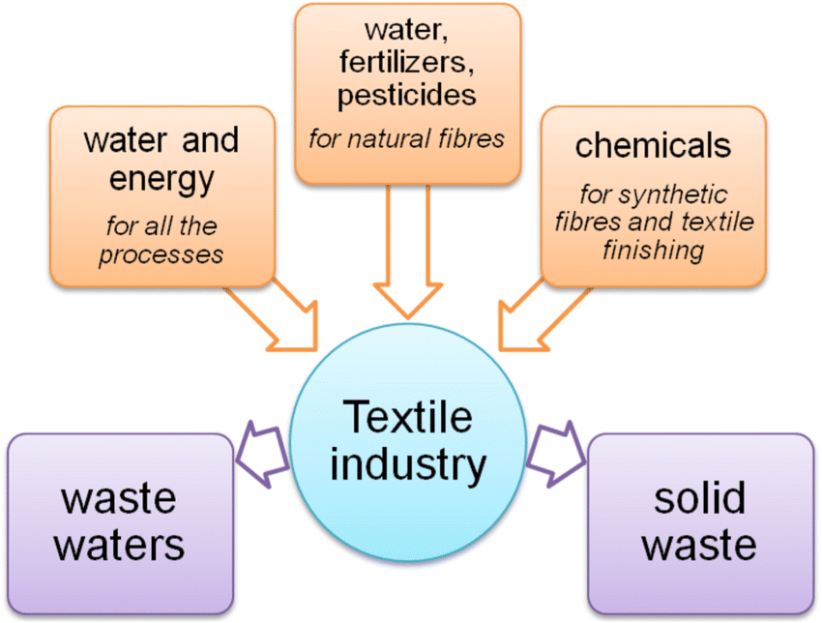
The textile industry is responsible for 10% of global carbon emissions.
It is reported to be the second most polluting sector in the world.

Slide 6
.
Concepts
02

Slide 7
Concepts
Traditional, linear economy
Stages of linear economy
Circular economy
In a circular economy, the cycle of raw materials is closed.
Stages:
Reuse
Repair
Upgrading of existing materials and products
Recycling
-Extraction/cultivation (raw material production phase)
-Manufacturing (industrial phase)
-Care, use, maintenance (consumer phase)
-Waste disposal/incineration (end-of-life phase)
.
Raw materials are extracted or cultivated and then processed into a product that is discarded after use.

Slide 8
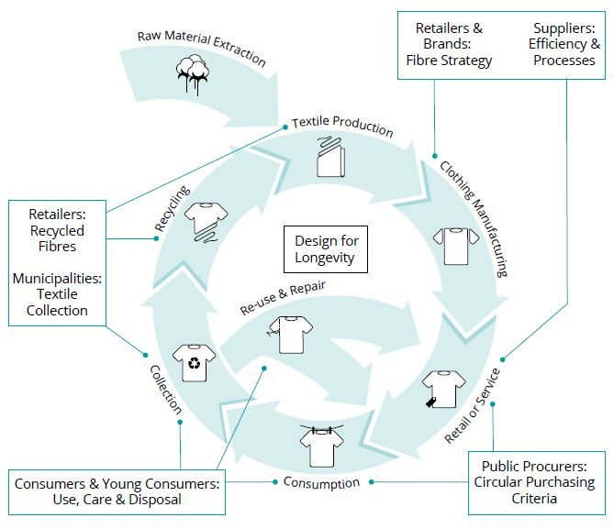
The circular model in textiles and clothing
Source: Dr. Kokasné Dr. Palicska Lívia (2021), p. 17 quoted by Élet és Tudomány (2022.september)
More information: https://tex2green.hu/files/fajl/iranyvaltas_a_ruhaiparban.pdf

Slide 9
Reuse
Textile reuse refers to the various means of extending the useful life of textile products, whereby textile products are transferred to a new owner with or without prior modification (e.g. repair).
Recycling
Recycling should be a last resort before throwing it away. This is because recycling is, among other things, cheaper, uses less energy and is less polluting than recycling.
Legal background Directive 2008/98/EC EU Commission 2014 (COM 398) Communication on the Circular EconomyNational legislative background.: Law CLXXXV of 2012 on waste
Click on the EU Commission Communication 2014 (COM 398)!
Click on the (Hungarian) Waste Act!
Notes:
Az újrafelhasználás és az újrahasznosítás környezeti előnyei
- Csökkenti a hulladéklerakók helyigényét (az égetés is helyet igényel).
- Kevesebb új anyagra és meg nem újuló erőforrásra van szükség.
- Általában kevesebb környezetszennyezés és energiafelhasználás, mint az új nyersanyagokból történő gyártás esetén.
9

Slide 10
Pre-use waste
Includes waste fibre and yarn, offcuts and unsold stock from traders. They are processed into new raw materials, especially non-woven materials.
Post-use waste
Discarded, worn, worn-out, etc. clothing or textiles. Recycled by charities or sold in second-hand shops, or thrown in landfills or incinerators..
Value-down recycling (down-cycling)
When the recycled material becomes of lower value (or quality) than the original product. Textile recycling processes are most often down-cycling. Clothing and home textiles are reprocessed, for example into industrial rags, low-quality blankets, insulation materials and upholstery.
Value-adding recycling (up-cycling)
If the product made from recycled material is of higher value (or quality) than the original product, then the recycling is value-adding.

Slide 11
Dilemma: reuse or recycle?
Reusing and recycling textiles is preferable to incineration and landfilling.
Reuse is preferable to recycling as it does not require additional energy use does not cause new pollution
Read more!
Gustav, Sandin & Greg M., Peters (2018) Environmental impact of textile reuse and recycling, Journal of Cleaner Production
Link: https://www.researchgate.net/publication/323423640_Environmental_impact_of_textile_reuse_and_recycling_-_A_review
Attention!!!!
During the recycling process, the quality of the fibres gradually deteriorates and eventually the waste is disposed of or incinerated.

Slide 12
Ideas
03
.

Slide 13
Issues in a possible planned investment. The environmental benefits of reuse and recycling
Does the use of the circular model contribute to reducing the negative environmental impacts of our waste?
What is the environmental impact of a potential new product made from recycled waste?
How clean is the manufacturing process of our new product and/or product made from recycled material?

Slide 14
Carbon footprint and life cycle analysis
PCF – Product Carbon Footprint
There are websites and applications on the web, that allow you to measure your "carbon footprint":
https://www.carbonfootprint.com/calculator.aspx
https://www3.epa.gov/carbon-footprint-calculator/
https://www.nature.org/en-us/get-involved/how-to-help/carbon-footprint-calculator/
LCA- Life-cycle analysis
The environmental impact of the planned investment is indicated by the product carbon footprint (PCF) and the product life cycle analysis (LCA).

Slide 15
Carbon footprint and life cycle analysis
How do we calculate the carbon footprint of a product?
The life-cycle greenhouse gas (GHG) emissions of a product or service are assessed.
Greenhouse gases are the gaseous components that absorb and re-emit infrared radiation. The main greenhouse gases are carbon dioxide, methane, nitrogen oxides and chlorofluorocarbons. Their concentrations have increased due to industrial activities.
Focus on greenhouse gas emissions!
The carbon footprint is an indicator of greenhouse gas emissions. There are several ways to calculate it.

Slide 16
Carbon footprint
How do we calculate the carbon footprint of a product?
To calculate the carbon footprint of a product, consider the following:
the production of the raw material,
the transport of the raw material to the processing plant
the production of the final product
packaging of the final product,
the production of the packaging delivery of the finished product consumption and
disposal of waste

Slide 17
LCA – Life Cycle Analysis
StepsDefining the objective and scopeInventory analysis (ISO 1404)
Impact assessment (ISO 1402)
Classification - assigning life cycle inventory (LCI) results to impact categories
Characterisation - calculating the magnitude of impact indicators.
Interpretation (ISO 14043) - draw conclusions and make recommendations.
Based on ISO 14040 Environmental Management - "Life Cycle Assessment - Principles and Framework." European Committee for Standardization, Brussels. 1997
Method:
The energy demand, Environmental emissions, solid waste assessment over the life cycle of a polyester bloom
Result:
Consumer use accounts for 86% of life-cycle energy demand. Cold wash-drying reduces washing energy by more than 90%. Air emissions and solid waste are also very high during the consumer phase.
ISO 14040 contains the steps of the LCA test

Slide 18
Life Cycle Analysis: examples
Women's knitted polyester blouse
Hotel linen
Method: Assessing energy demand, environmental emissions and solid waste over the life cycle of a polyester blend
Objective: To identify the best current ecological solutions for hotel textiles and services, to develop an ecological index for products and processes using 'best available technology'.
Cotton rolls used for hand drying
Simplified LCA for 10 000 hand-drying cotton-based towel rolls
Conclusion:Consumer use accounts for 86% of life-cycle energy demand. Cold wash - dry reduces the energy used for washing by more than 90%. Air emissions and solid waste are also very high at the consumer phase.
Conclusion:The washing process is the biggest environmental burden
Conclusion:The use of polyester-cotton sheets has fewer environmental consequences than 100% cotton sheets.
Source: Dahlöff, L. (2004) Life Cycle Assessment (LCA) applied in the Textile Sector
Notes:
18

Slide 19
The values in this row are summed up to obtain the impact assessment of the different phases (extraction, transport and storage of raw materials/resources, production (manufacturing, assembly), storage and use of the finished product, and waste management (transport, disposal, reuse, recycling).
The maximum value for each row is 15, which is the highest (worst) value for the environmental impact of the current/future product, and the minimum value is 5, which is the best (i.e. lowest possible) environmental impact.
Content of the self-assessment matrix
In the rows
include the extraction, transport, storage of resources, the production/assembly, storage, use and useful life of the finished product, followed by the transport and disposal of waste and the reuse of waste.
In the columns
is the energy consumption (1 - low, 2 - average or 3 - high), - waste generation (1 - low and non-hazardous, 2 - average waste, not particularly high or risky, 3 - high, also hazardous); - air pollution (1 - no air pollution at this stage, 2 - some air pollution but not significantly high; 3 - significant air pollution), - water pollution (1 - no water pollution at this stage; 2 - some air pollution under control (treated); 3 - process often pollutes water or is at high risk);soil contamination/use (1 - no soil contamination potential, 2 - process potentially contaminates soil but unlikely, 3 - frequent non-compliance).
Source: ENTeR Expert Network on Textile Recycling (2018) projekt

Slide 20
Környezeti hatás | Energy consumption |  |  | Waste production |  |  | Air pollution |  |  | Water pollution |  |  | Soil contamination |  |  | Total
 | 1 – Low energy consumption process | 2 - Average energy consumption | 3 - High consumption | - 1 Low waste, no hazards | 2 - Average waste | 3 - High volume and dangerous | 1 - No air pollution | 2 - Some air pollution, but notsignificantly high | 3 - Significant air pollution | 1 - No water pollution | 2 - Some pollution but under controlcontrol, (treated) | 3 – The process often pollutes the water | 1 - No soil contamination | 2 - The process potentially pollutes the soil, | 3 – Frequent violations of normal values | Summary of the values in the row
Stages | Before/after |  |  | Before/after |  |  | Before/after |  |  | Before/after |  |  | Before/after
Extraction
Transport
Storage
Production,assembly
Storagereadyproduct
Use, useful life
Waste transport
Waste disposal (incineration)
Waste recycling/reuse

Slide 21
Online database - collects materials and technologies (waste and non-waste) and helps you find out what to do with waste
Match Making Platform
What can we do ?
After creating an account on the platform, you can start sharing waste. Link to the platform: https://www.lifem3p.eu/en/
Watch the video!
https://youtu.be/FoN3UPV-CII

Slide 22
Waste hunting: Environmental information systems at national and EU level
OKIR
The vast majority of environmental information (e.g. air, surface and groundwater, waste, etc.) is stored in a single central database, the National Environmental Information System (OKIR)
It's good to know!Textile waste production The Hungarian textile industry produces only a small amount of waste compared to other industries and the national economy as a whole. According to data from the Hungarian Waste Information System (OKIR), between 2010 and 2017, there was no textile company among the 100 largest waste producers in Hungary.
E-PRTR
European Pollutant Release and Transfer Register
The European Pollutant Release and Transfer Register (E-PRTR) - a European-wide database that aggregates data on significant environmental releases from installations and organisations.
EIONET (European environment information and observation network)

Slide 23
.
ECO-labels
04

Slide 24
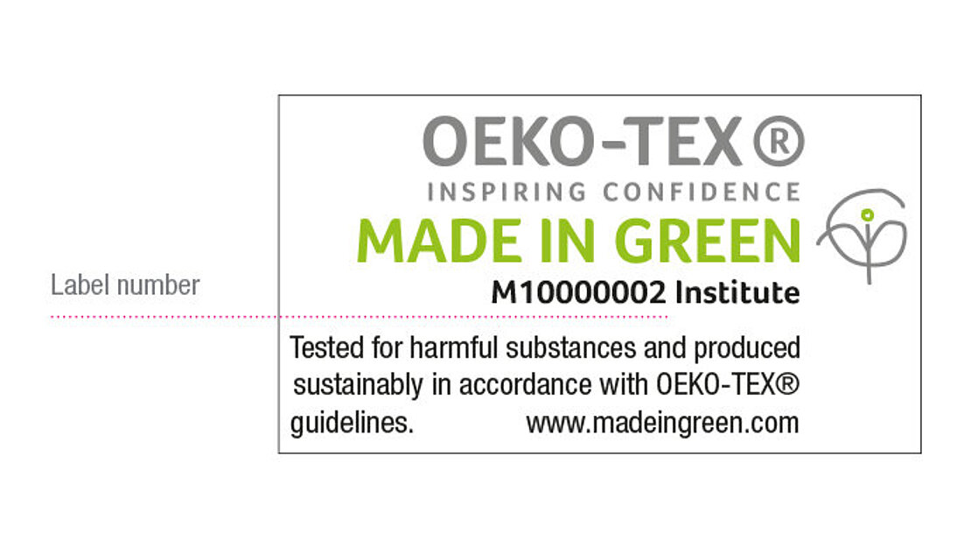
OEKO-tex and OEKO-tex labels - MADE IN GREEN
OEKO-TEX is made up of 17 independent institutes in Europe and Japan and contact offices around the world. It carries out textile and leather testing or other technological tasks.
OEKO-tex label: a traceable product label for textiles (e.g. clothing, home textiles) and leather products. The label content is uniquely complex and its validity can be verified by anyone.
The MADE IN GREEN product identifier indicates that the product has been tested for harmful substances. This is achieved through STANDARD 100 or OEKO-TEX® LEATHER STANDARD certification.
It also guarantees that the textile or leather product has been produced using sustainable processes under socially responsible working conditions.
This is done through certification according to OEKO-TEX® STeP. The unique product identifier allows the product to be traced. It can also identify where the different stages of the production of the product took place.
Find out more! Click to visit www.oeko-tex.com!

Slide 25
OEKO-TEX® STANDARD 100
OEKO-TEX® STANDARD 100 is the label and product certification for textiles tested for harmful substances. It indicates to the end user that the product is free from harmful substances and is therefore safe and skin-friendly.
The conditions for testing, certification and approval under OEKO-TEX® STANDARD 100 can be downloaded here: https://www.oeko-tex.com/importedmedia/downloadfiles/STANDARD_100_by_OEKO-TEX_R__-_Standard_en.pdf

Slide 26
ECO-PASSPORT by OEKO-TEX®
ECO-PASSPORT by OEKO-TEX® certification applies to chemicals used in sustainably produced textiles.
With this certification, OEKO-TEX® STANDARD 100 can be obtained at a lower cost.
On the OEKO-TEX website you can also check the validity of an OEKO-TEX® label by going to the "Label check" menu and selecting
https://www.oeko-tex.com/en/label-check

Slide 27
STeP by OEKO-TEX®
A STeP by OEKO-TEX® szabvány a textil és bőrtermékek teljes gyártási folyamatát értékeli fenntarthatósági szempontból.
A szabvány hat modulja nagyon szigorú környezetvédelmi és társadalmi követelményeket tartalmaz, és az auditorok mintegy 350 kérdést vizsgálnak az önértékelés és a helyszíni látogatások során.
Az értékelést követően a vállalat teljesítményét a szabvány 3 szintjének egyikére sorolják, és a vállalat ajánlásokat kap a fenntarthatósági teljesítményének javítására.
Azok a vállalatok, amelyek nem rendelkeznek vegyianyag-nyilvántartással vagy környezetvédelmi vezetési rendszerrel, nem kaphatnak tanúsítványt. Nem kaphatnak tanúsítványt olyan vállalatok sem, ahol gyermek- vagy kényszermunka, szexuális erőszak vagy elzárt vészkijáratok vannak jelen. Amint a kizáró okok megszűnnek, a vállalat újra kérelmezheti a tanúsítást.

Slide 28
Innovatext – the Hungarian member of the OEKO-Tex ®
Innovatext is independent Institute of Textile Engineering and Testing provides a wide range of services including quality control, environmental consultancy, laboratory testing and certification to OEKO-TEX® standards
What do the labels say? How to choose a label?
Listen to the KOSSUTH Radio 2022 broadcast on 27 September! (Sorry it is in Hungarian only!)
In the programme, a representative of the Association of Conscious Consumers and the CEO of INNOVATEXT Zrt. gave advice on how sustainability-conscious consumers should choose clothes and where to look for textiles produced under ethical conditions.
Az OEKO-TEX® maga 17 független európai és japán intézetből, valamint a világ minden táján működő kapcsolattartó irodákból áll, amelyek textil- és bőrvizsgálatokkal vagy egyéb technológiai feladatokkal állnak az Ön rendelkezésére
Link to the broadcast: https://mediaklikk.hu/radio-lejatszo-kossuth/?date=2022-09-28_09-05-00&enddate=2022-09-28_11-00-00&ch=mr1
9:34-től 9:56-ig

Slide 29
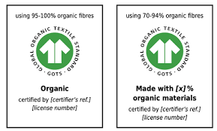
GOTS (Global biotextile standard)
The term "organic" refers to the use of at least 95% natural fibres, while the term "made with organic" refers to the use of at least 70% natural fibres.
"Certification under the GOTS as a processing standard starts with the first stage of processing of the textile fibers. For example, in the case of cotton, ginning is the first processing stage, when the seeds are removed from the cotton berries."
GOTS certification takes into account specific criteria such as social aspects, ethical business conduct and environmental management criteria at all processing stages
GOTS consists of four member organisations - OTA (USA), IVN (Germany), Soil Association (UK) and JOCA (Japan).
Source: https://global-standard.org/certification-and-labelling/who-needs-to-be-certified/first-processing-stages

Slide 30
EMAS (The EU’s Eco-Management and Audit Scheme)
To obtain EMAS registration, you need to:
carry out an environmental review;
an environmental policy and programme involving employees and external stakeholders;
the establishment of an environmental management system;
the preparation of an environmental statement;
verification of the environmental management system and environmental statement by an environmental verifier
Link to EMAS registration:
https://europa.eu/youreurope/business/running-business/developing-business/emas-registration/index_hu.htm

Slide 31
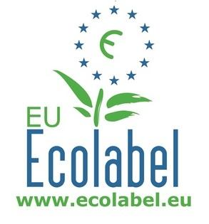
EU ecolabel
Only products and services of high quality and environmental excellence can be awarded the EU Ecolabel.
In Hungary, it is awarded by the Herman Ottó Institute Nonprofit Ltd.
For the textiles and clothing sector, it is regrettable that "out of more than 75,000 certificates issued for 24 product groups, only 7,200 textile and clothing products have been awarded the label".
Source: Dr. Kokasné Dr. Palicska Lívia (2022)) in Csémi Klára: Mit üzennek a cimkék? Riport a hiteles cimkékről, Divat&Marketing, 29.09.2022, https://divatmarketing.com/mit-uzennek-a-cimkek/

Slide 32
What should you do if you decide to apply for an eco-label?
The pre-application phase involves understanding the EU Ecolabel and then
Step 1: Contact the competent institution (in Hungary this is the Hermann Ottó Intézet Nonprofit Kft)
Step 2: Register your products or services in the EU Ecolabel online catalogue (ECAT)
Step 3: Compile your application documents with a description and testing of your goods and services
Step 4: Submit your application and pay the fees
Step 5: The competent institution evaluates your application
Step 6: Approve the application and grant the licence
Step 7: Communication about your EU Ecolabel products and services

Slide 33
What happens after an application is submitted?
The competent institution checks and assesses the compliance of the product with the criteria on the basis of the documents and certificates provided. In case of compliance, it issues a written decision to the competent minister.
The Minister decides whether to accept the application and award the EU Ecolabel.
If the application is accepted, the Minister authorises the competent institution to conclude a contract with the applicant and to publish the information on the EUEB website.
The institution shall publish the award of the Ecolabel on the Ecolabel website.
The institution shall check the compliance of the eco-labelled products regularly, and at least once during the duration of the contract. The audit may include checks on the applicant's premises and production processes. In case of non-compliance with the EU Ecolabel criteria, the organisation shall take the initiative to suspend or withdraw the use of the label from the Minister.
The Minister shall decide on the suspension or withdrawal of the EU Ecolabel.

Slide 34
Links to the ecolabel
The EU Ecolabel application form (Application Pack) can be downloaded from the EU Ecolabel website (http://www.ecolabel.eu)
The criteria for obtaining the eco-label can also be found here!
Further information for ecolabel in Hungary
https://okocimke.hu/eu-okocimke-megszerzese
http://www.hermanottointezet.hu/okocimke
http://www.hermanottointezet.hu/sites/default/files/palyazati_tajekoztato_unios_2021.pdf
Tájékoztatás az uniós szintű ökocímkéről:
http://www.ecolabel.eu

Slide 35
Standards
ISO 1400, Environmental management systems - Specification and user's guide. European Committee for Standardisation, Brussels. 1996
ISO/TR 14025, Environmental labels and declarations - Type III environmental declarations. International Organization for Standardization, Geneva, Switzerland. 2000
ISO 14040, Environmental management - "Life cycle assessment - Principles and framework. European Committee for Standardisation, Brussels. 1997
ISO 14040:2006 Environmental management, Life cycle assessment. Principles and framework
ISO 14041:2001 Environmental management. Life cycle assessment. Definition of purpose and scope and inventory analysis
ISO 14042:2001 Environmental management. Life-cycle assessment. Life cycle impact assessment European Committee for Standardization, Brussels. 2000
ISO 14043:2001 Environmental management. Life cycle assessment. Life cycle interpretation. European Committee for Standardisation, Brussels. 2000.
ISO 14050:1998, Environmental management - Glossary

Slide 36
Legal regulation
European Waste Framework Directive (Directive 2008/98/EC) (definitions of waste, recycling and recovery) Directive 2008/98/EC of the European Parliament and of the Council of 19 November 2008 Communication from the Commission 2014 (COM 398)
Towards a circular economy: A zero waste agenda for Europe
Hungary
Act CLXXXV of 2012 on Waste and Government Decree 225/2015 (VIII.7) on the conditions of activities related to hazardous waste. The Act covers all waste, all preventive activities, waste management and waste management facilities.
Act XCI of 2020 on banning the placing on the market of certain single-use plastics
Act II of 2021 amending certain laws on energy and waste management

Slide 37
Test - exercises

Slide 38
List the sources of pollution in the textile industry (List at least four sources!)
What is the difference between a traditional linear and a circular economy?
What are the elements of a circular economy?
What is the difference between reuse and recycling?
Which of the two involves less energy use and pollution?pollution, reuse or recycling? Which is more beneficial, reuse or recycling?
What is down-cycling and/or up-cycling?
What is the carbon footprint of a product?
What is life cycle assessment? What is the "cradle to grave" life cycle?
What can we do with our waste? How can I find useful waste for my company?
What are eco-labels? List some eco-labels!
Why is it useful to have an eco-label on your product?

